Slide 1

NW-PARALLEL PROJECT
October 31st, 2016
By: Blake Klasing & Stacy Gramajo

Slide 2

PROBLEM DEFINITION
Optimizing the execution time through a concurrent program for the Needleman-Wunch algorithm

Slide 3

Overview of NW Algorithm
Needleman-Wunch is also known as the global alignment algorithm
Discovers the optimal alignment between two sequences
Dynamic Programming Approach
Scoring System: GAP, MISMATCH, MATCH
Two Elements in NW:
1. Filling the Matrix
2. Trace Back
Time Complexity: O (mn)
Notes:
Global Alignment is show the relationship between the sequences
Matrix is the most expensive part

Slide 4

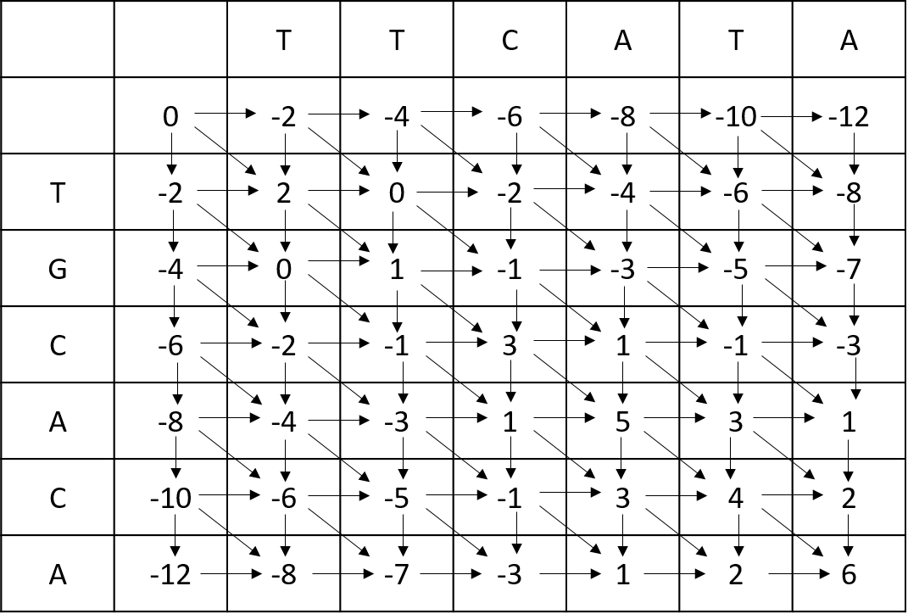
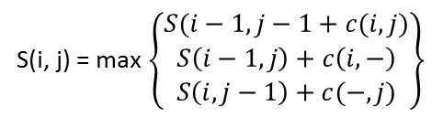
ALGORITHM IMPLEMENTED
Scoring System
Match 2
Mismatch -1
Gap -2
Dynamic Programming
Recursion
S(i, j) = max $\left\{\begin{aligned}S(i−1, j−1+c(i, j) \\ S\left(i−1, j\right)+c\left(i,−\right) \\ S\left(i,j−1\right)+c(−, j)\end{aligned}\right\}$

Slide 5

PARALLEL ALGORITHM FLOWCHART
Start
Initialize Data Structures / Variables
First cell added into the pool
Is the matrix complete?
Thread retrieves an item and starts computing
Thread adds another item(s) into the pool
No
Yes
End

Slide 6

BENCHMARKS USED

Slide 7

GRAPH: RESULTS

Slide 8
SUCCESS AND DIFFICULTIES
Template

Slide 9

CONCLUSION
Template

